Slide 1
Data Engineering Master Class

Slide 2
History of Data processing
COBOL(Common Business Oriented language)
COBOL is a programming language designed for Data Processing
First Serious attempt to Data Processing
Designed in 1959
Widely used in mainstream computes
Used in Business and Finance for companies and Governments
Allow store data in files, create index files, and process data efficiently
Used in large-scale batch and transaction processing jobs
Relational Databases
COBOL, then revolutionized to RDMS such as Oracle, MySQL, SQL Server,..
Oracle founded in 1977
SQL- An easy data query language
Scripting languages such as PL/ Transact SQL
Interface for other programming language such as JDBC and ODBC
Only able to deal with structured data

Slide 3
Structured Data
Semi Structured Data
Un-Structured Data
Data Categories

Slide 4
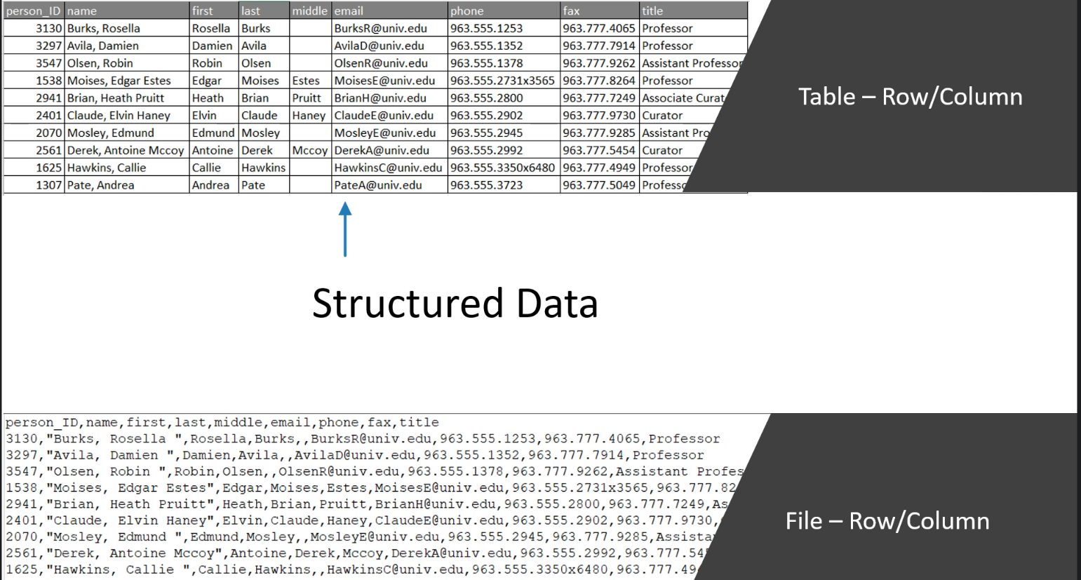

Slide 5
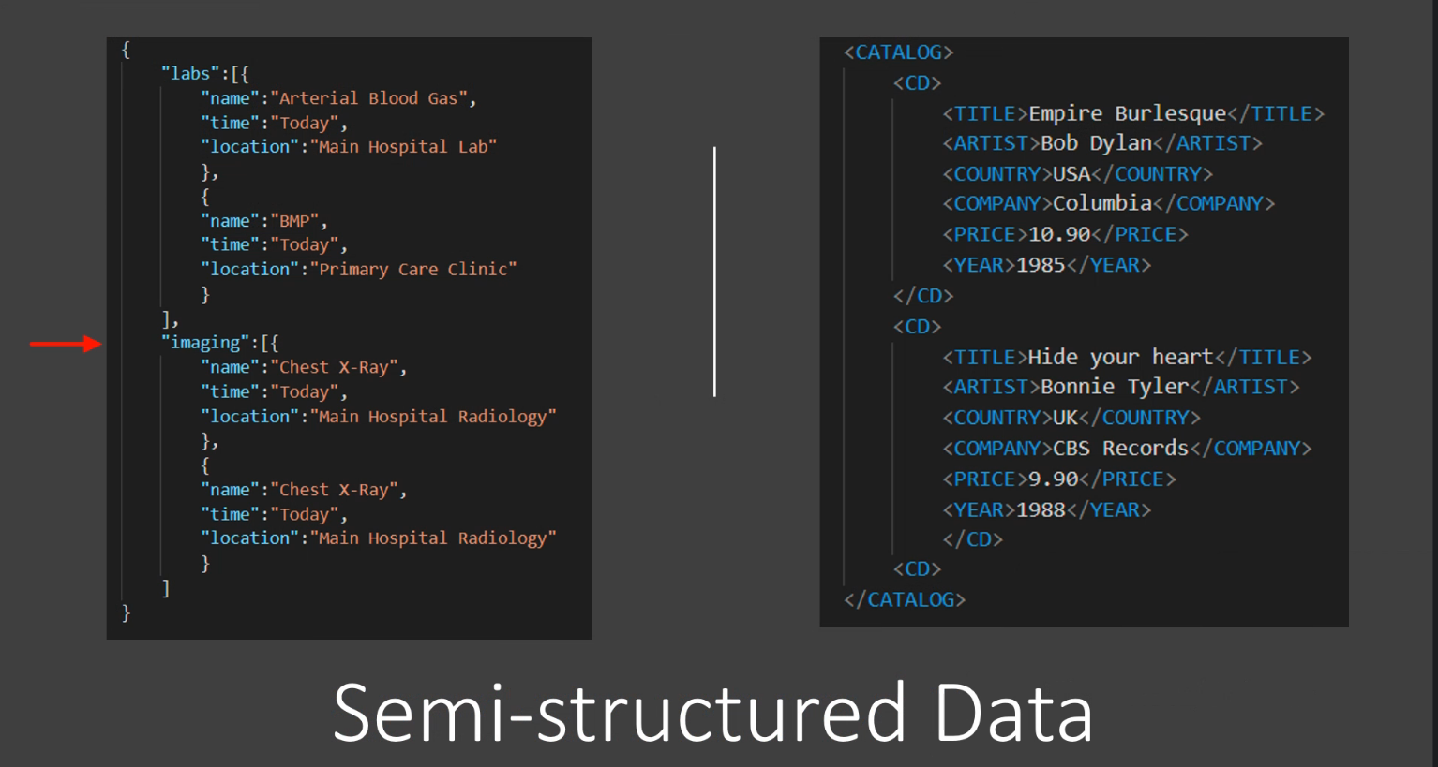

Slide 6
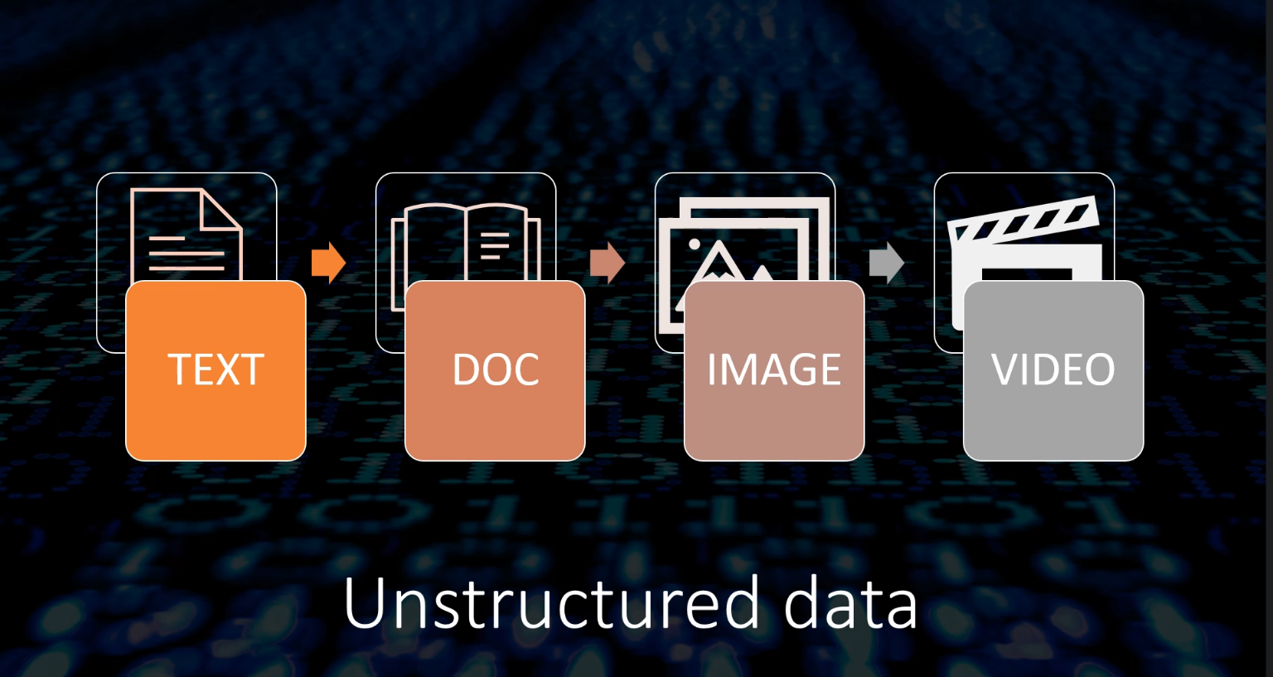

Slide 7
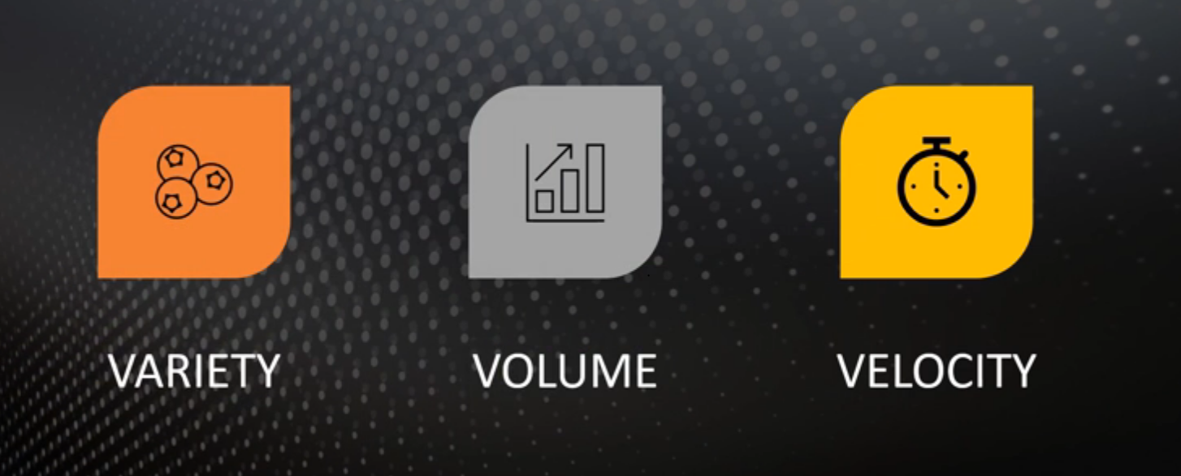
Big Data Problem

Slide 8
Summary
Data processing is one of the critical business requirement
We used RDBMS for decades to develop data processing applications
The advent of the internet started putting following data processing challenges
We started collecting verity of data
Structured Data
Semi Structured Data
Unstructured Data
Business started collecting high Data Volumes
Need to collect and process data at high velocity
The new data challenge is popularly known as Big Data Volumes
The Big Data problem was defined using the 3 Vs of Big data- Verity, Volume and Velocity
RDBMS failed to handle the Big Data problem
Industry needed a new approach or platform to handle the Big Data Problem

Slide 9
Two Approaches to Big Data Solutions
Monolithic approach
Distributed Approach

Slide 10
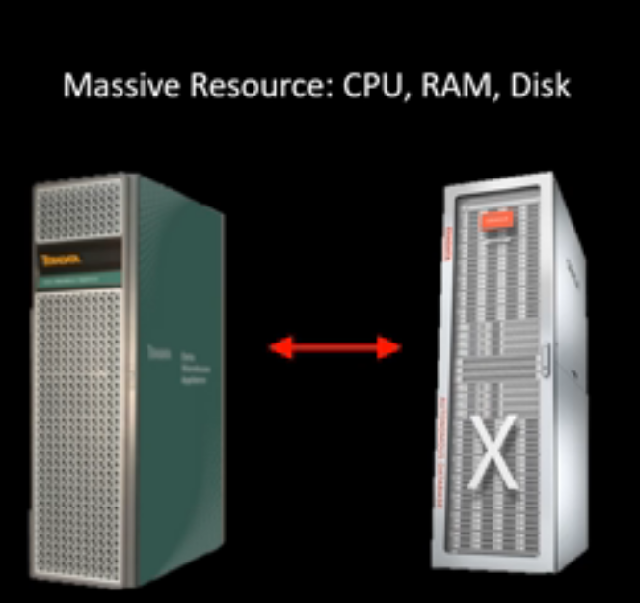
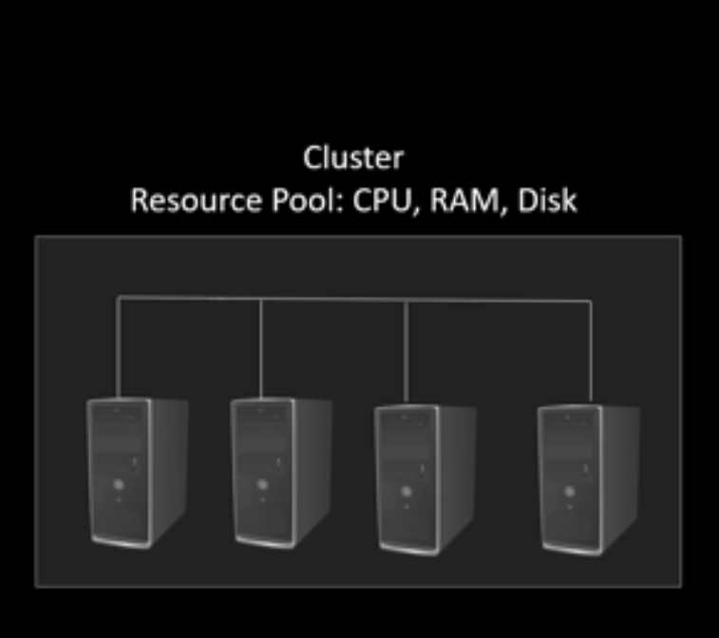
Monolithic Approach
Vertical Scaling(more time)
Less fault tolerance and less availability
Expensive
Eg: Teradata, Exadata
Distributed Approach
Horizontal Scaling(less time)
High fault tolerance and high availability
Economical
Eg: Spark

Slide 11

Introduction to Spark
Spark is a distributed computing platform
Spark application need a cluster
Spark can be deployed on different cluster managers, which are responsible for managing and scheduling resources across the cluster
Different Cluster managers are
Hadoop YARN (default)
Kubernetes
Apache Mesos
Spark Standalone
Databricks have its own cluster manager called the Databricks Unified Analytics Platform (UAP)

Slide 12
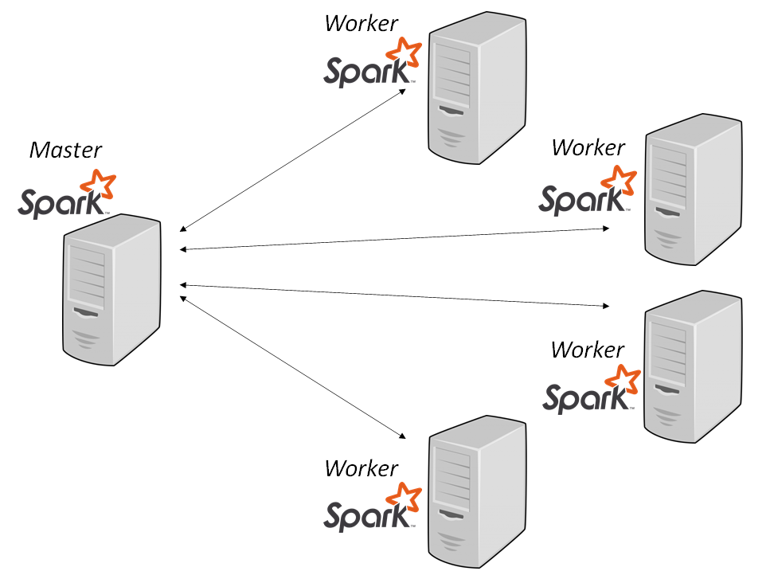
What is a Cluster?
A pool of computers working together but view as single system
Example cluster capacity
Worker Node capacity
16 CPU Cores
64 Gb RAM
Cluster capacity
64 CPU Cores
256 Gb RAM

Slide 13
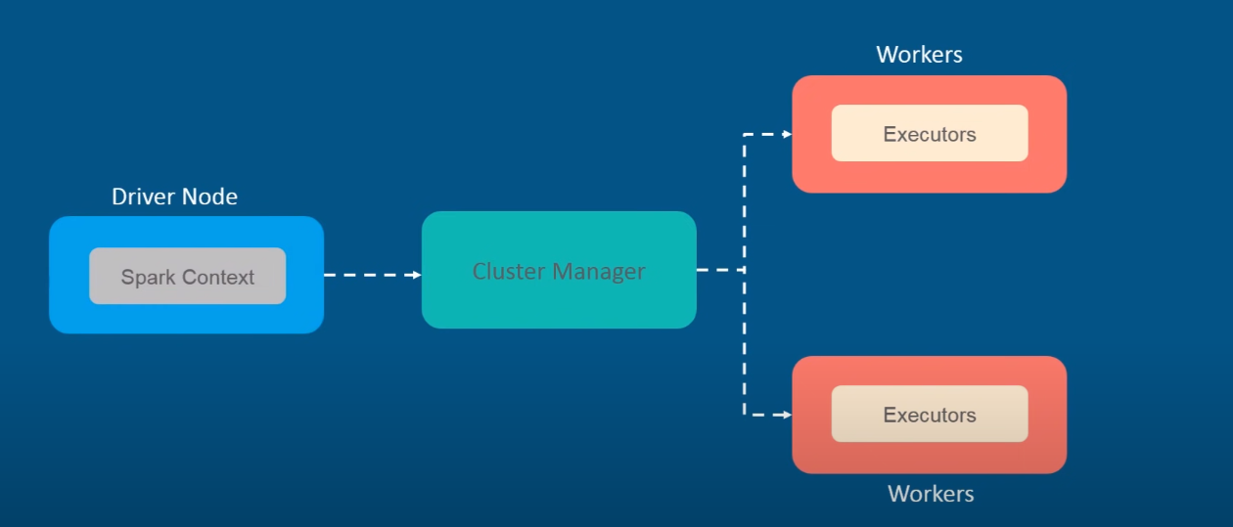
Spark Architecture

